Slide 1
Fluctuating Power Logic: SCA Protection By V_{DD} Randomization At The Cell-level
Fan Zhang, Bolin Yang, Bojie Yang, Yiran Zhang, Shivam Bhasin, Kui Ren
Notes:
Hello everyone, my name is yangbolin and today I want to share the work which name is Fluctuating Power Logic. SCA Protection By V_{DD} Randomization At The Cell-level.

Slide 2
Content
1. Introduction
2. FPL scheme
3. Simulation
4. Conclusion
Notes:
I will show this work in four parts and first is introduction

Slide 3
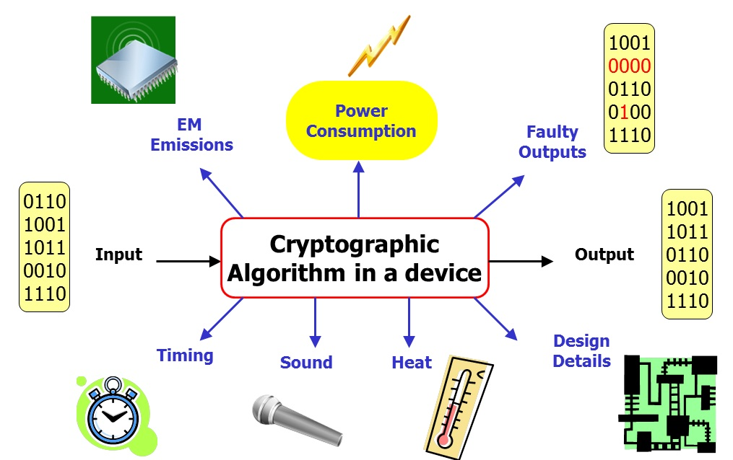
1. Introduction
Side-Channel Attack
Power dissipation correlates to switching operations
Power models like hamming weight etc.
Major power consumption comes from the clock distribution network and Flip-Flops
(FFs) (estimated 30%-60%)
Notes:
The SCA in the title means side channel analysis. And it cares about the power dissipation correlations with switching operations using power models like hamming weight
And it will lead to threats to information security
We investigated that Major power consumption comes from the clock distribution network and Flip-Flops (FFs) (about 30%-60% of the whole consumption is from FF
So our work concentrate on improving the flip-flops

Slide 4
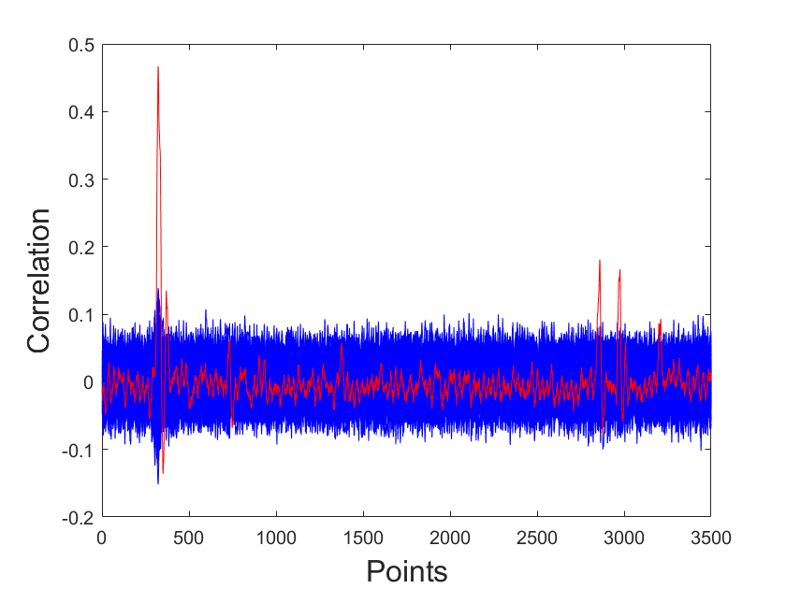
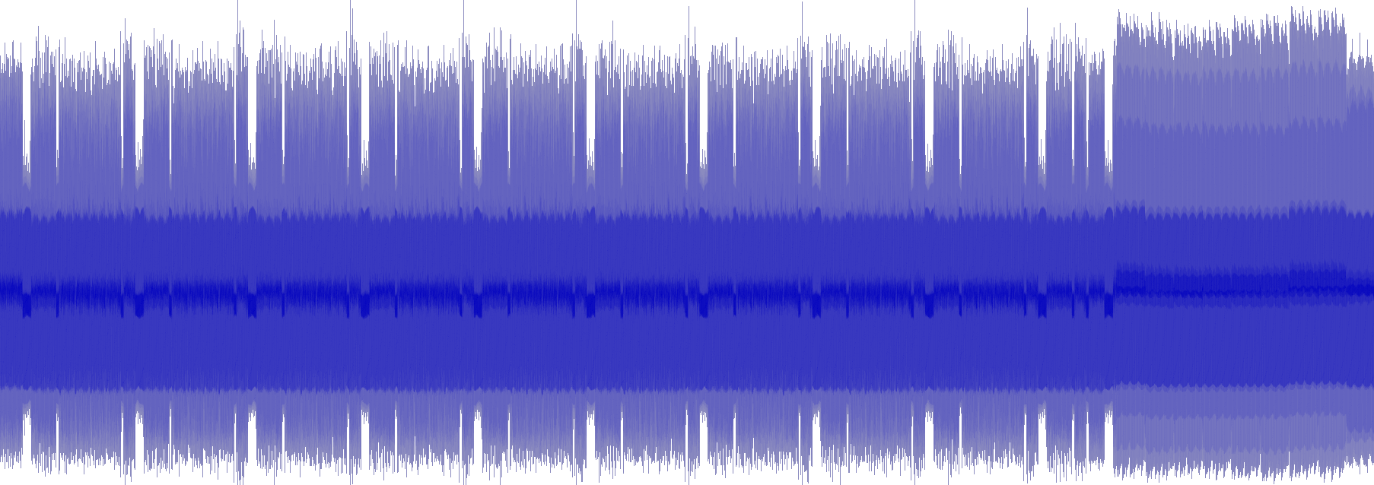
Side-Channel Attack Methods
SPA(simple power attack),DPA(differential power attack)
CPA(correlation power attack)
CPA
Notes:
The three common methods to implement the side-channel attack are SPA,DPA,and CPA
And in this work, we use correlation power attack to analysis the security of the implementation
The correlation power attack utilize the correlation between power model and real power consumption
And once the correlation value has a peak, it often means a true key guess

Slide 5
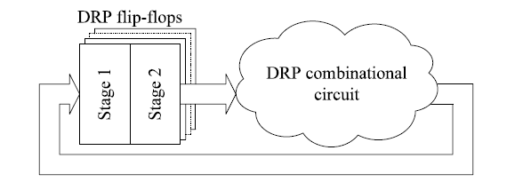
Mainstream SCA countermeasures
Hiding :noise, clock randomizer, dual-rail precharge logics (DPL)
Notes:
There have some countermeasures to overcome the severe challenge of SCA. The two mainstream SCA countermeasures are hiding and masking.
Hiding means we can use noise, clock randomizer or dual-rail precharge logics to hide the dependence between the power consumption and data
And masking can de-correlate the dependency between the actual data and the power model by algorithm or some hardware model

Slide 6
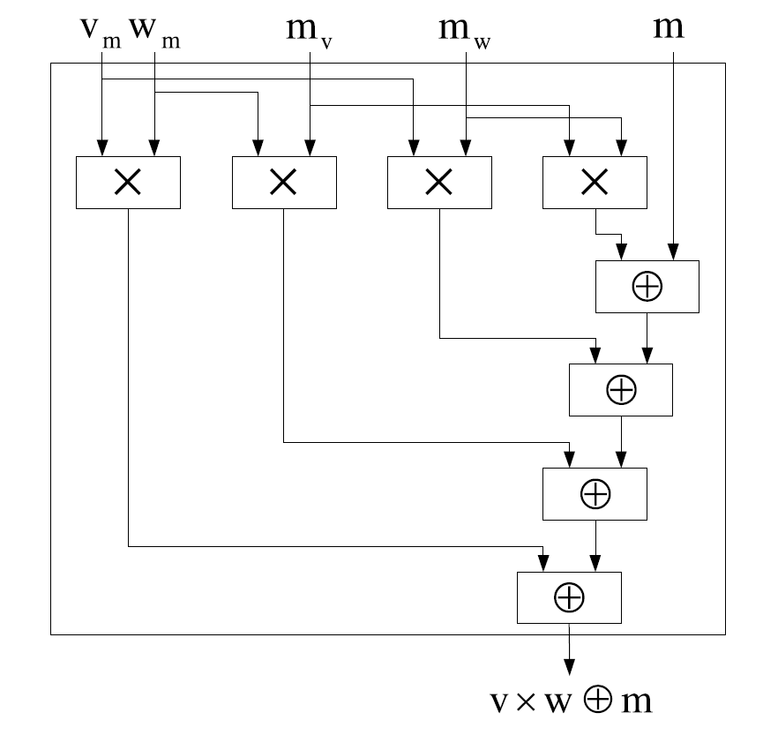
Mainstream SCA countermeasures
Masking: algorithm level, hardware level
Notes:
And masking can de-correlate the dependency between the real data and the power model by adding a variant m to data with algorithm or some hardware model

Slide 7
Wave Dynamic Differential Logic (WDDL)
One of the dual-rail precharge logic based on standard cell flow, proposed by K. Tiri
require a very strict complementary capacitive balance, making it difficult to implement in practice
Notes:
WDDL is one implementation of DPL based on standard cell flow
But it require a very strict complementary capacitive balance, making it difficult to implement in practice
We will compare the performance between WDDL and our work

Slide 8
New countermeasure: FPL
Notes:
The correlation of the three part is shown in the picture. The masking and hiding care more about the power model.
Our work aims to remove the correlation between key-dependent data and power dissipation directly, regardless of whether the power model is known to the adversary.

Slide 9
Our contributions
We propose a novel cell-level logic: Fluctuating power logic(FPL)
We compared FPL with standard-cell-based and WDDL-based implementation
We analyzed side-channel security of FPL on PRESENT/AES implementation

Slide 10
Content
1. Introduction
2. FPL scheme
3. Simulation
4. Conclusion
Notes:
The second part let me introduce the FPL scheme

Slide 11
2. FPL scheme
The proposed logic is highlighted with a modified secure FF.
This scheme is based on a cascade voltage logic(CVL) and further enhanced with a compensatory unit (CU).

Slide 12
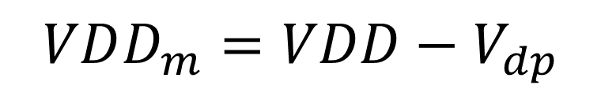
cascade voltage logic(CVL)
n NMOS,
n diodes
one PMOS
one “n-input” OR-gate.
V_{dp}: voltage drop
$$VDD_{m}=VDD−V_{dp}$$
Notes:
the CVL unit is connected to VDD and a PRNG pseudo random number generator. consists of n NMOS and n diodes
Then it has one PMOS and one n-input OR-gate. The input of the OR-gate is controlled by PRNG
And the CVL unit will produce a OUTPUT named vddm to substitute the VDD with a random voltage drop.

Slide 13
cascade voltage logic(CVL)
n NMOS,
n diodes
one PMOS
one “n-input” OR-gate.
V_{dp}: voltage drop
$$VDD_{m}=VDD−V_{dp}$$
Notes:
the CVL unit is connected to VDD and a PRNG pseudo random number generator. consists of n NMOS and n diodes
Then it has one PMOS and one n-input OR-gate. The input of the OR-gate is controlled by PRNG
And the CVL unit will produce a OUTPUT named vddm to substitute the VDD with a random voltage drop.

Slide 14
cascade voltage logic(CVL)
n NMOS,
n diodes
one PMOS
one “n-input” OR-gate.
V_{dp}: voltage drop
$$VDD_{m}=VDD−V_{dp}$$
Notes:
the CVL unit is connected to VDD and a PRNG pseudo random number generator. consists of n NMOS and n diodes
Then it has one PMOS and one n-input OR-gate. The input of the OR-gate is controlled by PRNG
And the CVL unit will produce a OUTPUT named vddm to substitute the VDD with a random voltage drop.

Slide 15
cascade voltage logic(CVL)
K=0 ,V_{dp}=0
K=1, V_{dp}=V_{th0}
K>1, 0<V_{dp}<V_{th0}
K denotes the total number of VM_{i} whose logic value is “1”
V_{th0} denotes the threshold voltage of NMOS and diode
Notes:
To exactly know the value of the voltage drop, Let me use K denotes the total number of VM_{i} whose logic value is “1” and also equal to the output of PRNG
If K equal to 0 all NMOS are shut off, the OR-gate output digital 0 and the output equal to VDD
K equal to 1 only one of Vmi equal to 1, the voltage drop equal to threshold voltage
If there are more than one Vmi equal to 1, the value of drop voltage will be between zero and threshold voltage
Depending on the values of VMi in the CVL unit, resulting in different discrete power consumptions for data transition in the whole FPL circuit.

Slide 16
cascade voltage logic(CVL)
K=0 ,V_{dp}=0
K=1, V_{dp}=V_{th0}
K>1, 0<V_{dp}<V_{th0}
K denotes the total number of VM_{i} whose logic value is “1”
V_{th0} denotes the threshold voltage of NMOS and diode
Notes:
To exactly know the value of the voltage drop, Let me use K denotes the total number of VM_{i} whose logic value is “1” and also equal to the output of PRNG
If K equal to 0 all NMOS are shut off, the OR-gate output digital 0 and the output equal to VDD
K equal to 1 only one of Vmi equal to 1, the voltage drop equal to threshold voltage
If there are more than one Vmi equal to 1, the value of drop voltage will be between zero and threshold voltage
Depending on the values of VMi in the CVL unit, resulting in different discrete power consumptions for data transition in the whole FPL circuit.

Slide 17
cascade voltage logic(CVL)
K=0 ,V_{dp}=0
K=1, V_{dp}=V_{th0}
K>1, 0<V_{dp}<V_{th0}
K denotes the total number of VM_{i} whose logic value is “1”
V_{th0} denotes the threshold voltage of NMOS and diode
Notes:
To exactly know the value of the voltage drop, Let me use K denotes the total number of VM_{i} whose logic value is “1” and also equal to the output of PRNG
If K equal to 0 all NMOS are shut off, the OR-gate output digital 0 and the output equal to VDD
K equal to 1 only one of Vmi equal to 1, the voltage drop equal to threshold voltage
If there are more than one Vmi equal to 1, the value of drop voltage will be between zero and threshold voltage
Depending on the values of VMi in the CVL unit, resulting in different discrete power consumptions for data transition in the whole FPL circuit.

Slide 18
cascade voltage logic(CVL)
CP: circuit on critical path
NCP: circuit on non-critical path
Notes:
The components in the original circuit C can be split into two parts, i.e.,those on and off the critical paths denoted as CPi and NCPi, respectively.
In order to avoid that the vddm influence the performance of the circuits, we just connect the vddm to non-critical path of the circuit and vdd is still connect to the critical paths

Slide 19
Modified FF with FPL
Critical paths marked in brown
Non-critical paths marked in blue
Transistors connected with VDD_{m}
marked in grey
Notes:
the critical paths are marked in brown and those components off the critical paths which are connected with VDDm are marked in blue like pull-up unit, feed-back unit and so on

Slide 20
compensatory unit (CU)
The power consumption for variant data transitions (0 →1 and 1→0) is larger than that for invariant ones (0→0 and 1→1)
The compensatory unit make up the power consumption during invariant data transition

Slide 21
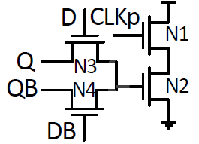
compensatory unit (CU)
When the FF makes a 0→1 or 1→0
the CU is off
when the inputs of FF keep unchanged
the CU is turned on
Notes:
And we use compensatory unit to enhance the scheme. Because that the power consumption for variant data transitions (0 →1 and 1→0) is larger than that for invariant ones (0→0 and 1→1)
When the FF makes a 0 to 1 or 1 to 0 transition during the clock pulse window (tCLKp ), one of the pass-transistor gates controlled by D or DB is switched off while the other one outputs 0. So the CU is off.
Otherwise, when the inputs of FF keep unchanged, the CU is turned on, which consumes compensatory dynamic power during CLKp.

Slide 22
Total Power dissipation
Notes:
As aforementioned, the total power of FPL-FF (Ptotal) consists of three parts: the power of original FF (PFF ), the power of CVL unit
(PCV L) and the power of CU (PCU). So the randomness of power is derived from the uncertain sum of three parts relying on VDDm.

Slide 23
Content
1. Introduction
2. FPL scheme
3. Simulation
4. Conclusion
Notes:
The third part, I will show the simulation we did for FPL

Slide 24
3. Simulation
Testbench
compiling and synthesis by Design Compiler
n=4
HSPICE
Notes:
For the purpose of illustration, only the case of n equal to 4 is applied and verified in the same test bench for both algorithms
And we do compiling and synthesis by Design Compiler (DC)
In this simulation setup, all power traces are acquired from ideal digital circuits by detailed transistor level simulation through HSPICE
The applied experiment setup consists of two 4/8-bit input registers(Data, Key), one 4/8-bit output register, one 4/8-bit XOR gate and
the SBox module from the PRESENT/AES algorithms

Slide 25
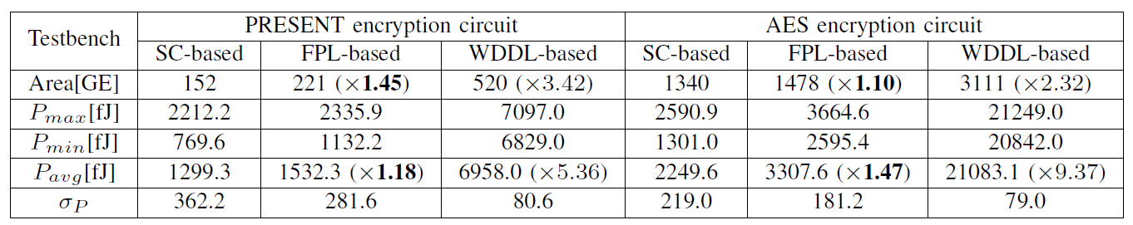
Simulation results
（GE）Gate equivalents
(SC-FF) standard-cell-based FF
(WDDL) dynamic differential logic
Notes:
To be specific, the Gate equivalents (GE) of SC-, FPL- and WDDL-based testbench implementations are summarized in the first row of Table.
Pavg and P are the mean and standard deviation
We can see that, although FPL-based FF use more gates and power, but it performance is better than WDDL-based schemes.

Slide 26
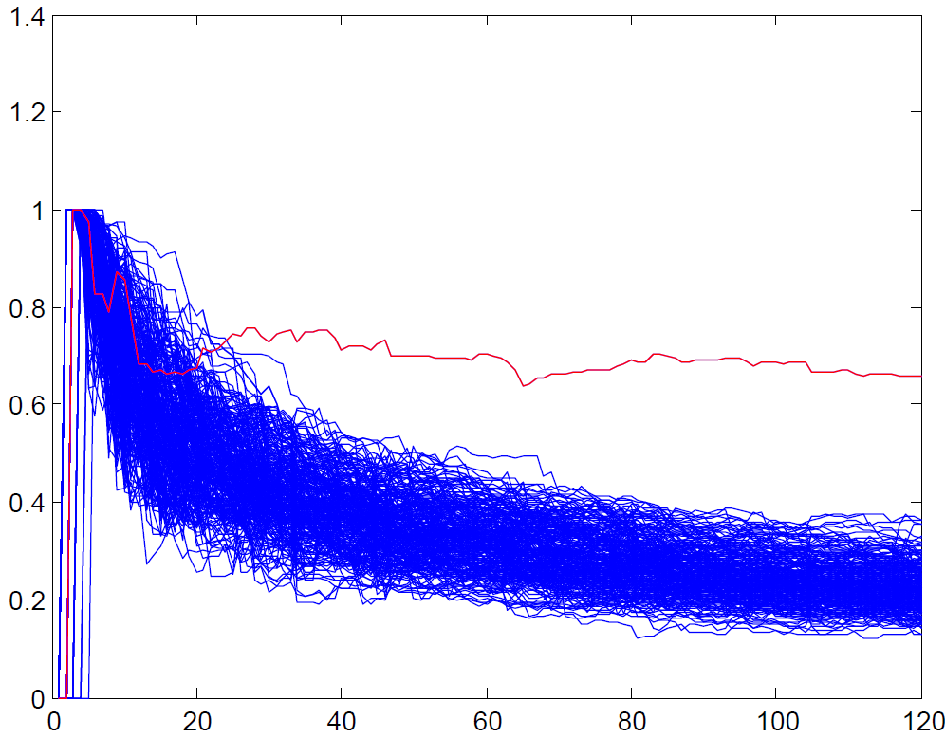
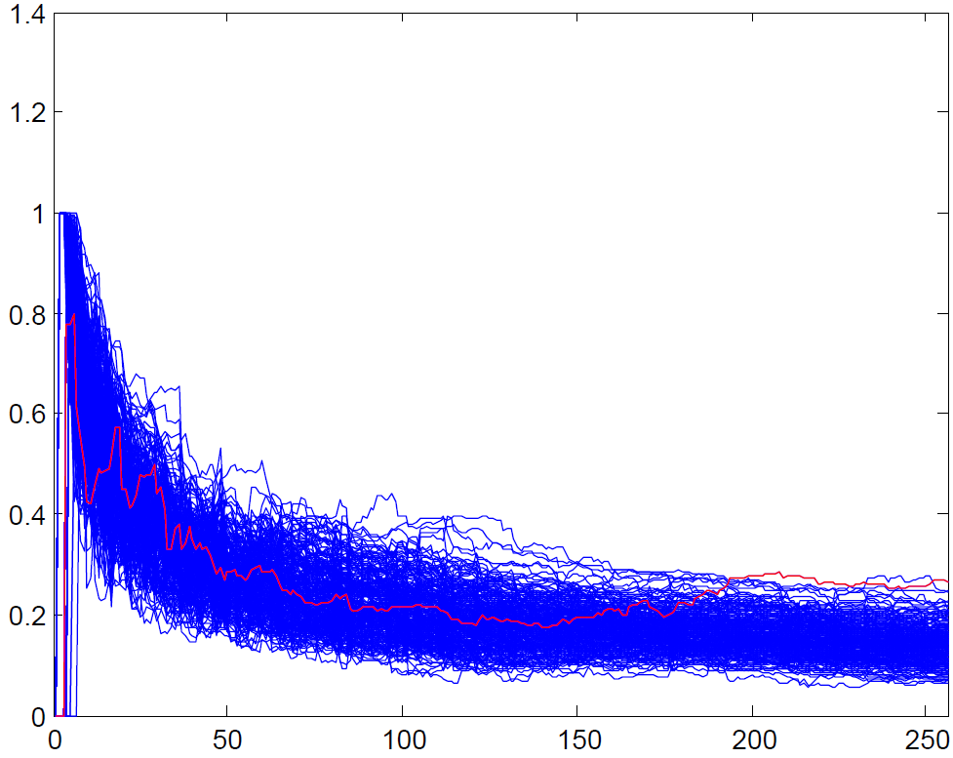
Comparation(AES)
Correlation vs. number of traces
Standard FPL
Notes:
The simulation results are plotted here.
We compare standard AES implementation and FPL based AES implementation and these are correlation to number of traces
As you can see, in standard implementation, the correlation of the right key guess is the red line and will appear using thirty traces
But in FPL implementation, it need at least two hundred traces.

Slide 27
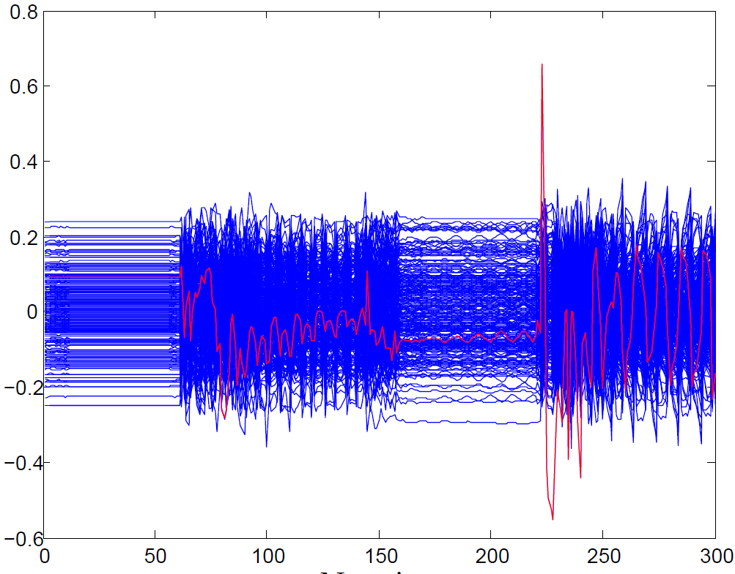
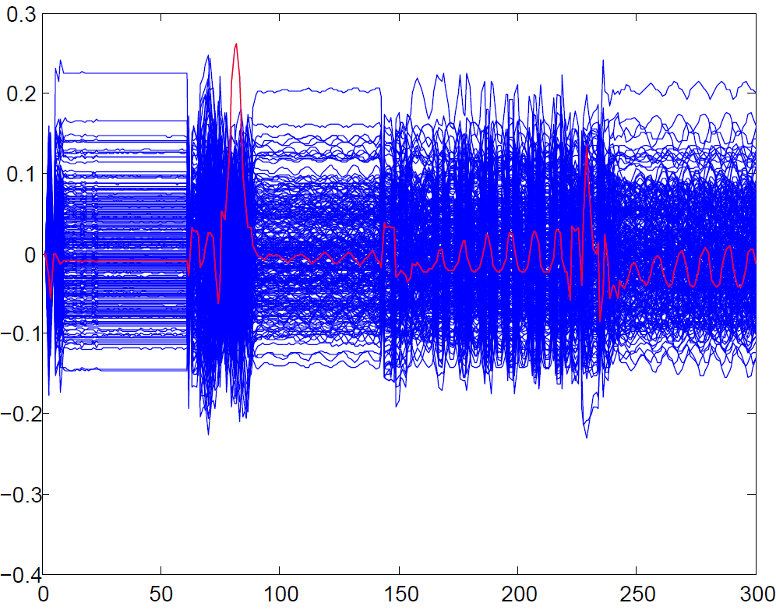
Comparation(AES)
Correlation vs. length of a trace
Standard AES PFL AES
Notes:
these are plots of correlation to length of a trace
We can see there is a obvious peak of correlation in standard implementation but there is no peak in FPL implementation

Slide 28
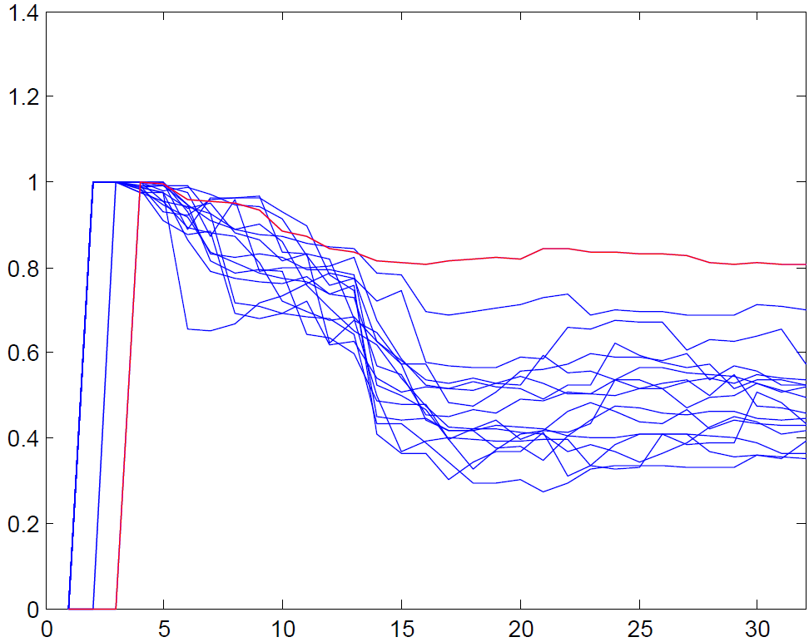
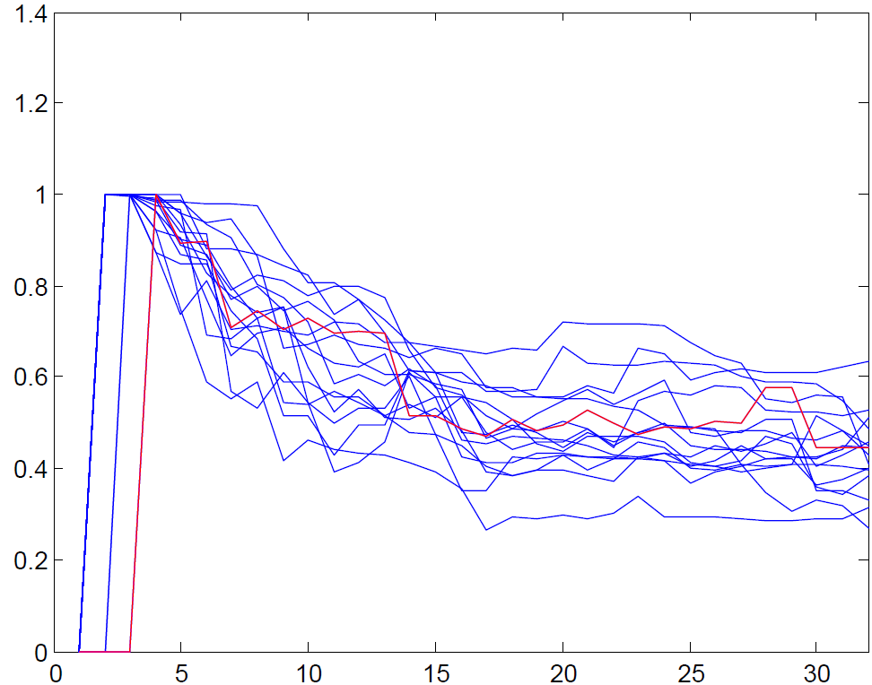
Comparation(PRESENT)
Correlation vs. number of traces
Standard FPL
Notes:
We can see the same result in PRESENT
The right guess will appear at about fifteen traces and didn’t appear in FPL implementation

Slide 29
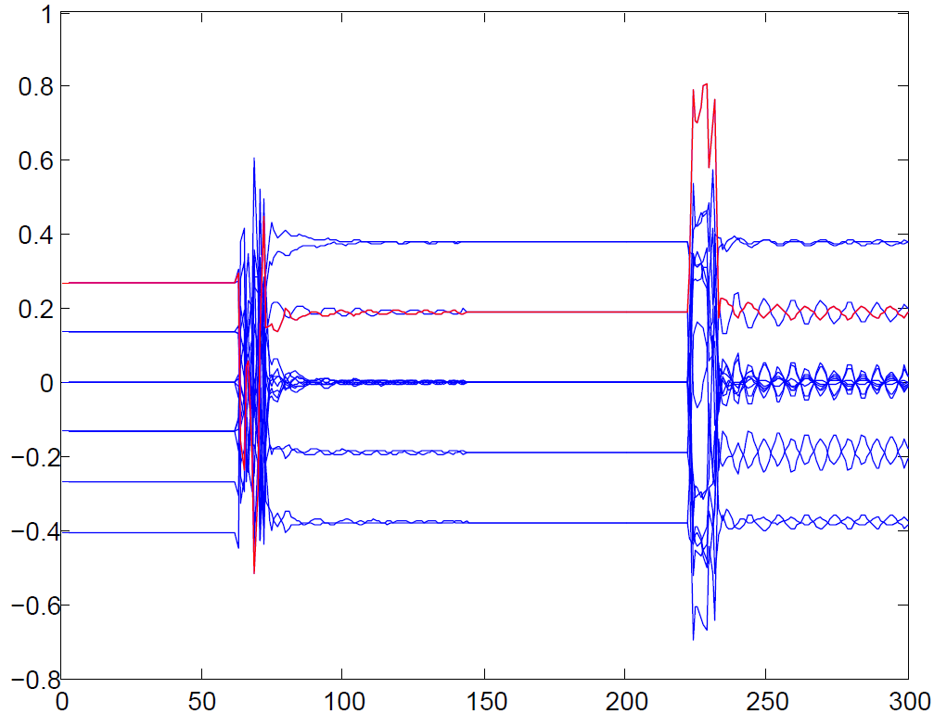
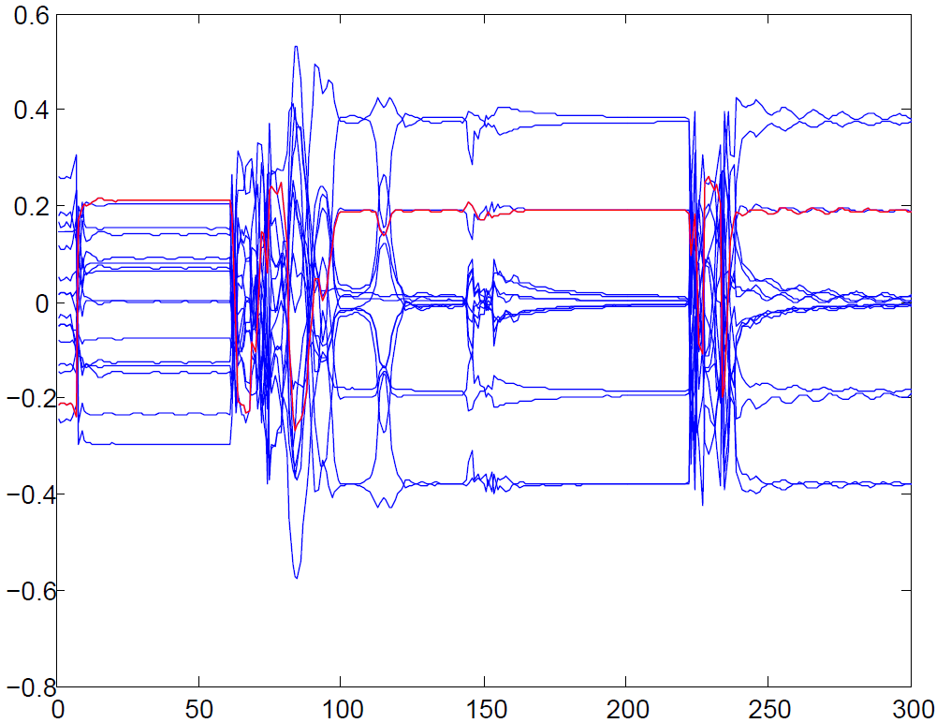
Comparation(PRESENT)
Correlation vs. length of a trace
Standard FPL
Notes:
these are plots of correlation to length of a trace
We can see there is a obvious peak of correlation in standard implementation but there is no peak in FPL implementation

Slide 30
Content
1. Introduction
2. FPL scheme
3. Simulation
4. Conclusion

Slide 31
Conclusion
proposed a power-diffusing logic named as fluctuating power logic (FPL)
analyzed side-channel security on PRESENT/AES implementation
compared FPL with standard-cell-based and WDDL-based implementation

Slide 32
Thank you~

